Slide 1



Name - Surname: Rabia GÜL Department: Process Design and Product Development Mentor: Ali TIRAK
İstanbul Medipol University Department of Electrical and Electronics Engineering & Biomedical Engineering GPU: 3.35
rabiagul0311@gmail.com
(+90) 533 519 60 68
Notes:
Hi everyone! Welcome to my presentation.
Today, I will be presenting you my final project, which is about investigating the role of innocuous pain stimulation in human machine interface enhancement.
Before I start the presentation, I would like to thank my advisor Elif HOCAOGLU and all of the faculty members who support me in this project.

Slide 2
The presentation planned to be made at the end of the internship could not be presented due to the Corona Virus. For this reason, the presentation slide was prepared by adding the information would be explained orally during the presentation.

Slide 3
During the internship, Printed Circuit Board (PCB) manufacturing process was learned and the devices which are used in this process was examined. A detailed research was done on these devices and the information which are obtained were reported.
Flow diagram of the PCB manufacturing
Preparation of the Components
Preparation of the SMD
PCB Cleaning
Assembly of the SMD
Automated Optic Inspection
Selective Soldering
Environmental Test
X-ray Analyzer
Quality Control
Flying Probe Test
Electrical Test
Conformal Coating

Slide 4
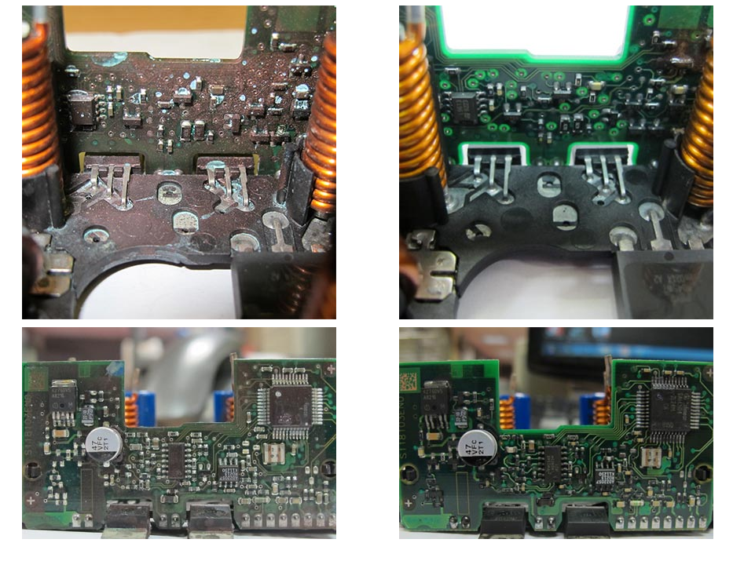
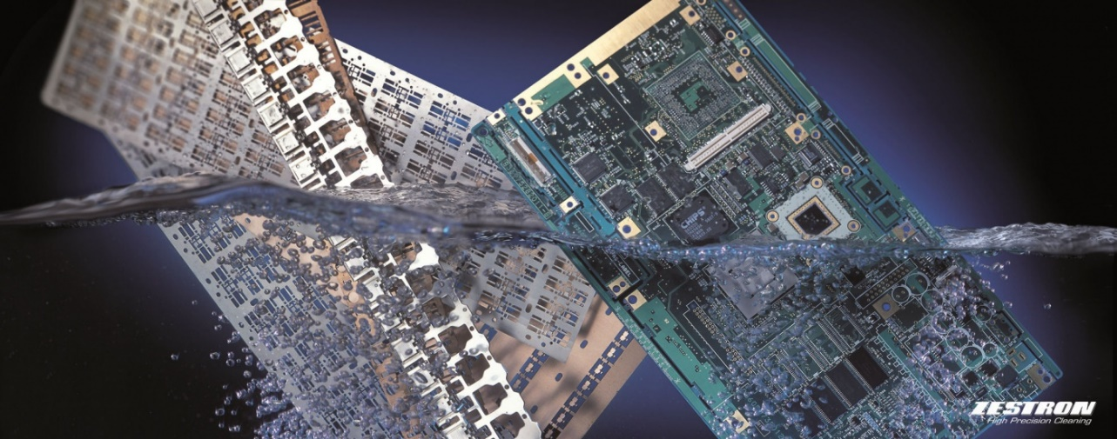
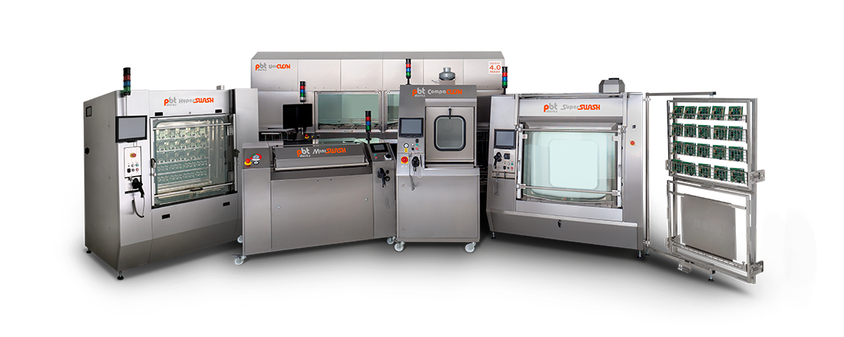
PCB Cleaning
Purpose of the PCB Cleaning
Removing resin and flux residues from filled boards and hybrids
Before circuit board is cleaned
After circuit board is cleaned
Over time, water, dust and dirt can enter your to the devices and accumulate to a point where needed to act to prevent permanent damage to the equipment.
Unwanted material formation causes overheating and component failure.

Slide 5
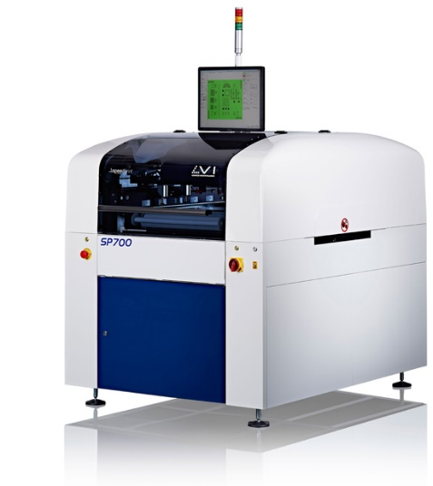
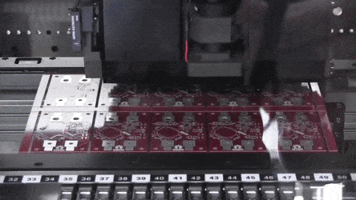
Assembly of the SMD
Speed Print
→ When considered the assembly of the components to the blank printed circuit board (PCB), Liquid solder can be printed on the blank PCB with the help of a sieve in the screen printing machine.
The sieves used while printing and the device used in liquid solder printing is "Speedprint SP700". SP700 series SMT stencil printers are designed for Surface Mount Technology (SMT) production processes.
SMT materials are placed on automatic assembly machines on blank PCB printed with liquid solder.

Slide 6
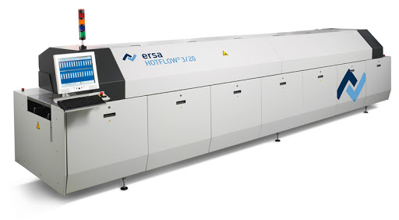
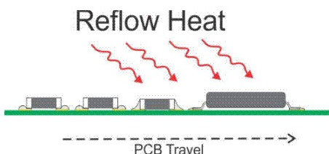
Assembly of the SMD
Reflow Oven
→ The components that are mounted in automatic assembly machine are baked to cure the liquid cream on the PCB. "Reflow" and "Vacuum Vapor Phase" oven are used for this process.
The aim of the process is to form solder joints by first pre-heating the components, PCB, solder paste and then melting the solder without causing damage by overheating.
Reflow soldering requires a screen process.
In the screen printing process, a paste containing both solder and flux is administered to the PCB solder pads.
To solder the components to the board, a stream of hot air or radiant heat is applied to the whole board.
This evenly heats up the board, the components, and the solder paste, melting the solder in the paste and connecting the components to the board.

Slide 7
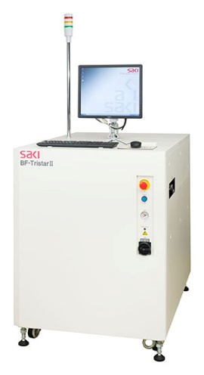
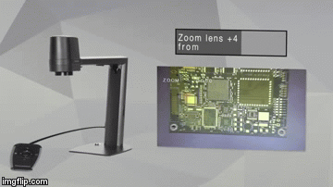
2D/3D Automatic Optic Inspection (AOI)
→ After the assembly of the PCB cards is completed and the soldering process is done, an optical inspection is made to check whether the components are correctly mounted to the cards and the soldering is smooth.
AOI is an automatic visual inspection of a PCB where a camera is used to scan the board in extremely fine detail to check for any defects or defects.
Pattern matching algorithms keep track of both successful and failed PCB assemblies.
In some cases, implementation, cost factors, and acceptable process parameters may make a 2D machine the better choice, but in other cases the same factors may make a 3D AOI system the better choice.
AOI is a vital inspection system that allows you to measure and monitor the quality of your PCB production and fix any problem or defect at any strategic point in the process flow.
Limitations of 3D Systems:
Cannot control 2D elements
Significant cost increase
Significant reduction in speed
Height limitation
Shading issues
No color control

Slide 8
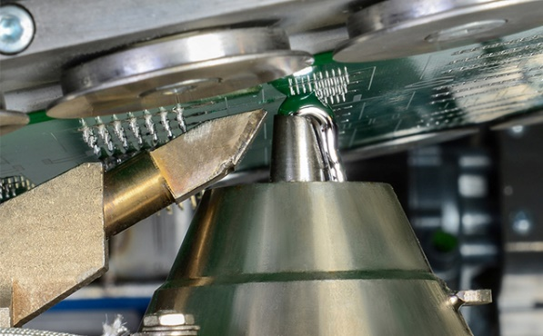
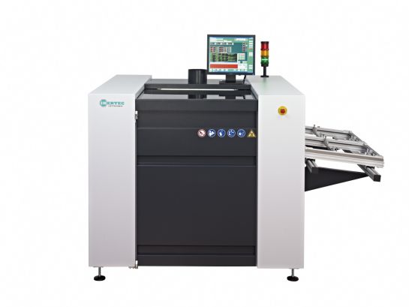
Selective Soldering
→ The assembly of the elements that are not SMD material on the card and that need to be soldered manually with a special tool or device is applied by "Selective soldering" or "soldering iron".
SMT packages are more precise and expensive and must be soldered in a reflow furnace. However, some cards still require punched pins. This poses a minor problem because the hollow pins cannot be soldered in a reflow furnace and must be soldered separately. This can be done by hand or with a selective soldering machine.
Selective soldering is used for soldering printed circuit boards assembled with partially or fully perforated components. Selective soldering consists of three steps;
1) fluxing or liquid flux application,
2) preheating or printed circuit board assembly,
3) soldering with a site-specific soldering nozzle.

Slide 9
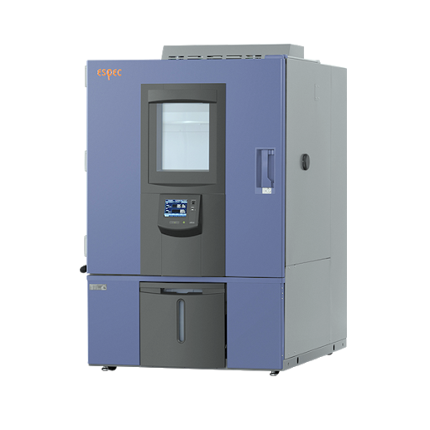

Workspace of Pantograph
Environmental Test Chamber
→ In order to test the quality of the PCB, materials and cards are subjected to high-speed temperature cycles to reveal possible defects and make the necessary corrections. "Espec" device is used for this process.
An environmental test chamber is an enclosed space that essentially recreates conditions to determine how a subject will respond to those simulated conditions. These may include;
extreme heat,
sub-zero temperatures,
relative humidity,
dew point,
wet environments
The environmental chamber can be used to study product performance under a given set of conditions, or to accelerate product lifetime and study the product aging process.

Slide 10
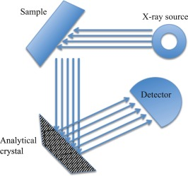
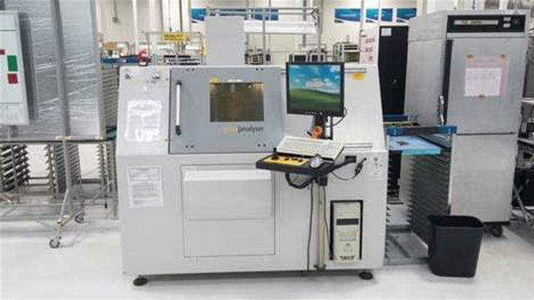
X-ray Analyzer and Quality Control
→ BGA, PGA, the elements whose legs are under the body and the elements with spacers are used at the bottom are checked for solder in the X-ray inspection device. "Phoenix PCBA Analyzer" device is used for this process.
The PCBA analyzer is a high resolution micro focus X-ray system equipped with an open tube from x-ray dedicated to the study of printed circuit board assemblies. Compared to other inspection methods, X-ray can enter the inner packaging and inspect the quality of solder joints.
When it comes to PCB inspection, X-ray is extensively used in the PCB assembly process to test the quality of PCBs, which is one of the most important steps for quality-oriented PCB manufacturers.

Slide 11
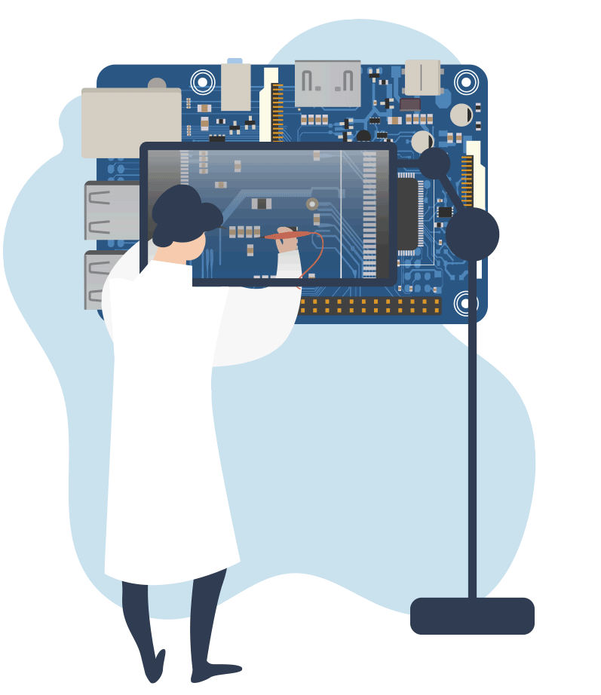
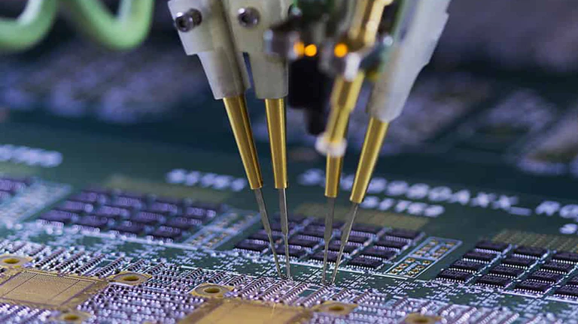
Flying Probe Test & Electrical Test
Flying probes are electro-mechanically controlled to access components in printed circuit assemblies. The probes are moved around the tested board using an automatically operated two-axis system, and one or more test probes touch the components of the board or test points on the printed circuit board.
During the electrical test, the functional behavior of the PCB card is followed and examined, and the function test is performed.

Slide 12
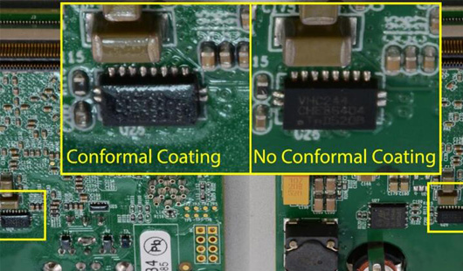
Conformal Coating
→ During conformal coating, areas where the card should not be coated are masked. A conformal coating is applied on the card to prevent the card from being affected by the external environment. If the coating is not applied, situations such as oxidation may occur.
Purpose of the conformal coating
Protecting electronic circuits from harsh environments that can include high humidity, various airborne contaminants and varying temperatures
The advantages of the conformal coating can be ordered like;
Insulation properties may allow a reduction in PCB conductor spacing
Can help eliminate the need for complex, advanced containment
Ensure a longer service life

Slide 13
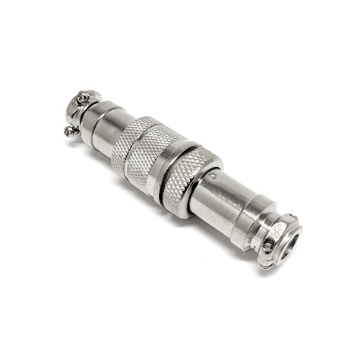
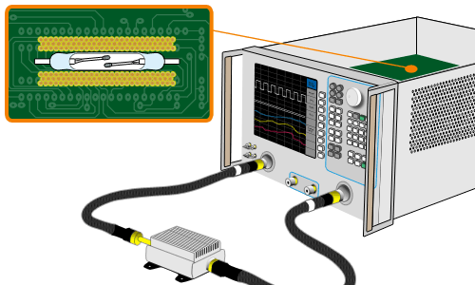
Radio frequency (RF) signals are high frequency signals, and since there are not enough devices to measure current and voltage of high frequencies, s-parameters are used, in which power values are used instead of current and voltage variably to overcome this problem.
During the internship, the connectors determined to be used in a project carried out by Aselsan were subjected to temperature testing in the environmental test laboratory. Ten cycles were applied here with a temperature change from -45 degrees to 100 degrees. The s-parameters were measured by using PNA network analyzer before and after testing to make a comparison and interpret the behavior of the connectors. A literature survey was done and reported on the topics what are the s-parameters while waiting for the test to be completed.

Slide 14
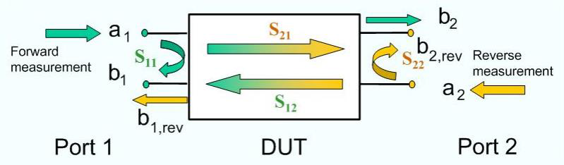
S-Parameters (Scattering Parameters)
Scattering parameters describes the input-output relationships between ports in an electrical system. Specifically at high frequency it becomes essential to describe a given network in terms of waves rather than voltage or current.
Assuming a two-port line, the wave representations will be as follows;
S11 → the input port voltage reflection coefficient
S12 → the reverse voltage gain
S21 → the forward voltage gain
S22 → the output port voltage reflection coefficient
DUT = Device Under Test
Many electrical properties of circuit elements (inductance, capacitor, resistance) such as gain, return loss, voltage standing wave ratio, reflection coefficient and amplifier stability can be expressed using S parameters.

Slide 15
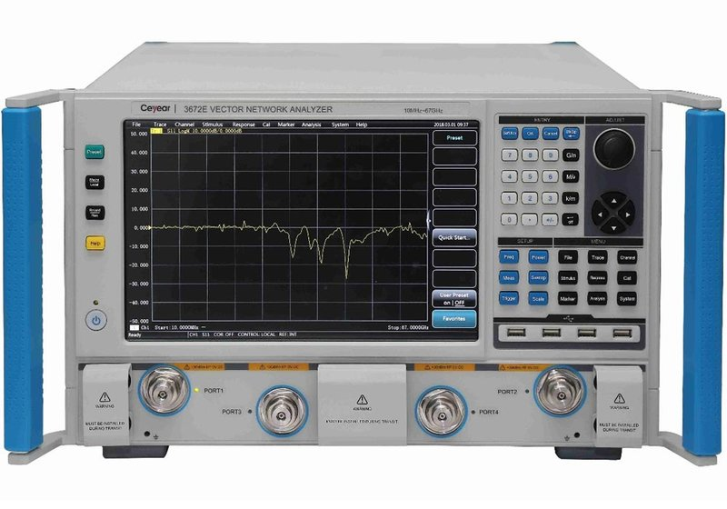
Vectork Network Analyzer
→ The Vector Network Analyzer which is used during the measurement of S-parameters was examined and the collected information was documented.
Purpose of the Vector Network Analyzer
Applying a signal of known amplitude and phase to the input of the system to be tested and to give information about the system structure by looking at the signal at the output of the system
Vector Network Analyzer performs two types of measurements
S12 and S21
S11 and S22
Transmission
Reflection
Passing the Vector Network Analyzer stimulus signal through the device under test
Measuresing the signal that travels back towards the source due to reflections

Slide 16
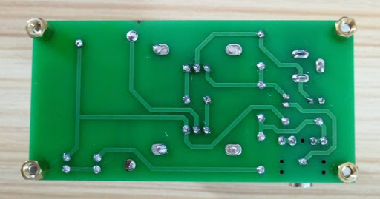
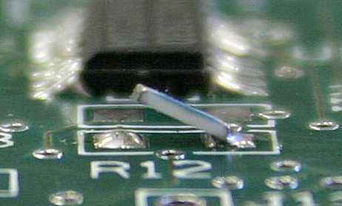
Two of the devices that I have seen in the PCB manufacturing laboratory that are used during the assembly of the components on the PCB cards are the Reflow Oven and the Vacuum vapor phase soldering machine. Vacuum vapor phase soldering is used to get rid of the "Void Problem", which is a problem occured in the use of reflow oven. However, it is seen that "Tombstone Problem" is encountered during the use of this device. Upon the request of the mentors, a detailed research has been made and presented to find a solution to this problem encountered in the Vacuum vapor phase soldering machine.

Slide 17
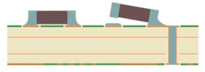
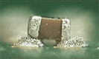
Tombstone Problem
The tombstone problem is a defect that occurs when passive SMT components are partially or completely lifted from the PCB pad.
What usually occurs is that one end of chip is soldered on the PCB pad while opposite end of the chip stand ups vertically, looking similar to a tombstone in a cemetery.
The root cause of the tombstone problem is that the wetting properties cause an imbalanced torque at the two ends of the chip terminals when the solder paste starts to melt.
The primary cause of the tombstone defect is the difference in the wetting effect / surface tension of the molten solder on the pads of the small passive components.

Slide 18


Solution to the Tombstone Problem
The vacuum vapor phase soldering machine significantly reduces the oxidation on the surface by the help of the its vacuum properties. Therefore, their initial wetting time will be very short and fast. Thus, the temperature change in the pads accelerates and a temperature difference occurs between the terminals of the components. This temperature difference causes the solder to melt earlier at one end of the component. As a result, it can be said that the tombstone problem occurs. It is necessary to ramp the temperature and apply a temperature gradient to the vacuum vapor phase soldering process to avoid this problem. This will prevent the temperature rising suddenly at a terminal of the material. In addition, if the solder paste used is kept very thin, the possibility of melting of the solder at the two ends at the same time can be kept at the highest possibility.

Slide 19

Unit design
Pin To Pin Mapping
The unit design of the two jammer systems which are used in a project carried out by Aselsan was observed and investigated. Pin to pin mapping in unit has been completed to make the unit design. While doing this, the pin-to-pin mapping of the components was performed by the help of the documents that belong to these components.

Slide 20


